Slide 1
Second week Update (Research for dataset)
Yueyang Qin
Koganti Sri Harsha

Slide 2

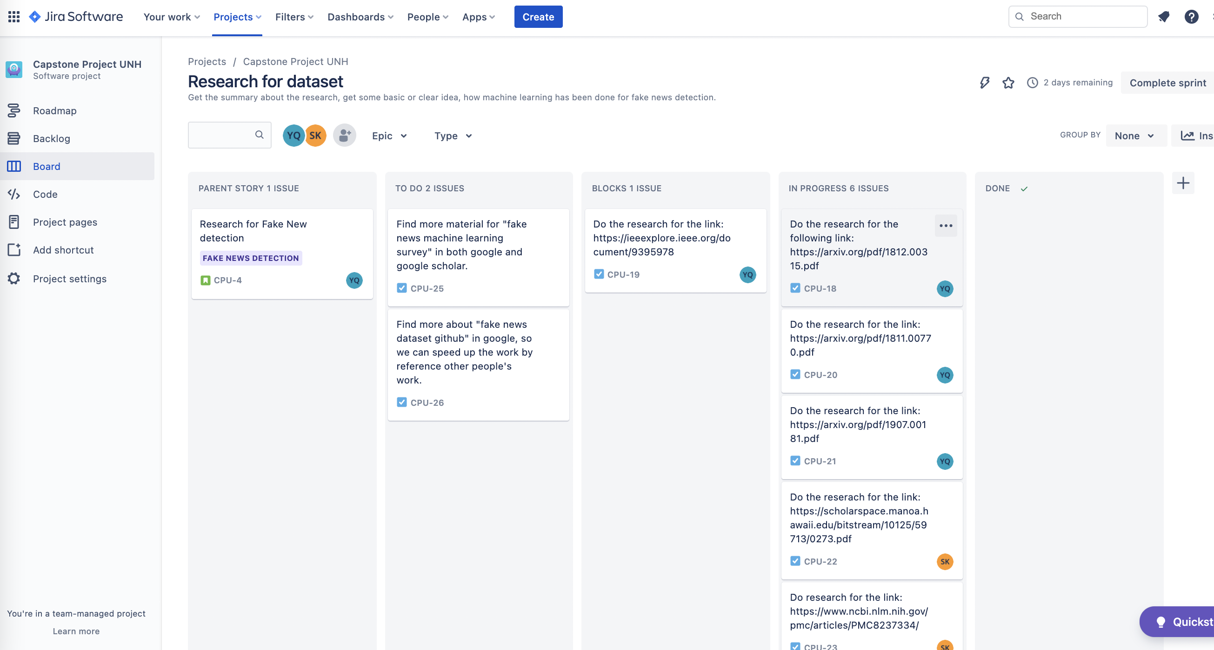
Jira software board

Slide 3
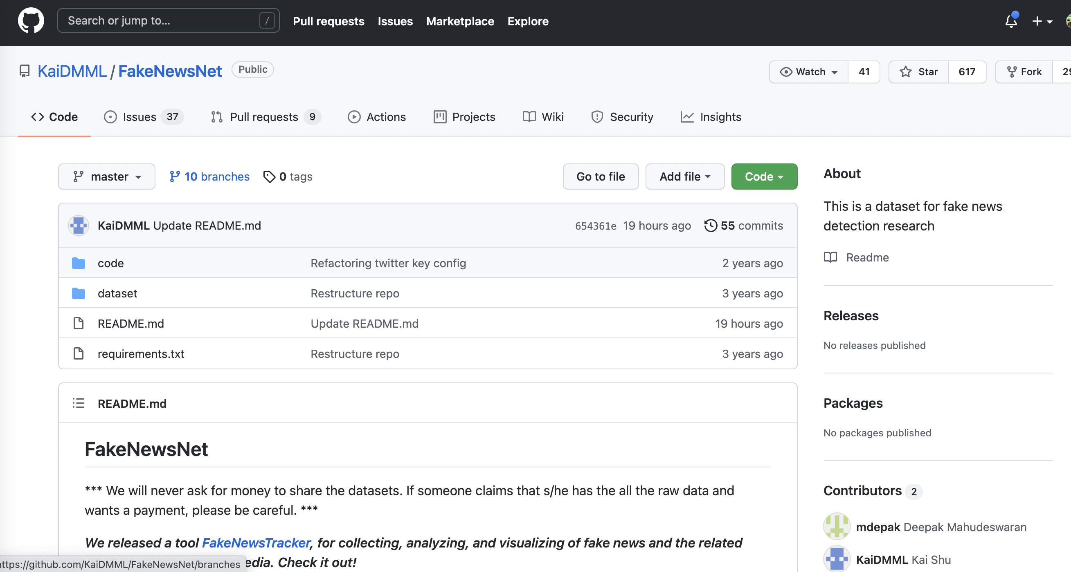
Politifact dataset github: https://github.com/KaiDMML/FakeNewsNet

Slide 4
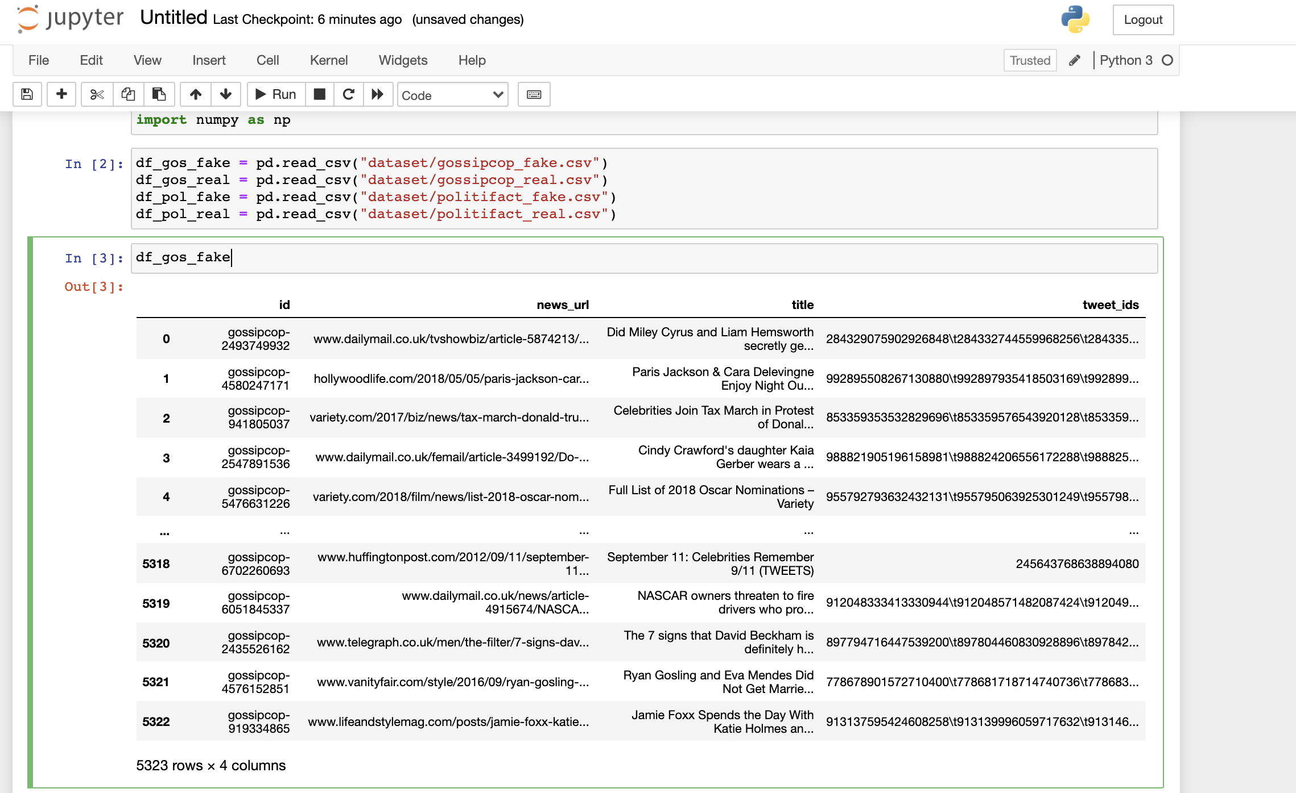
Dataset we go through with notebook

Slide 5
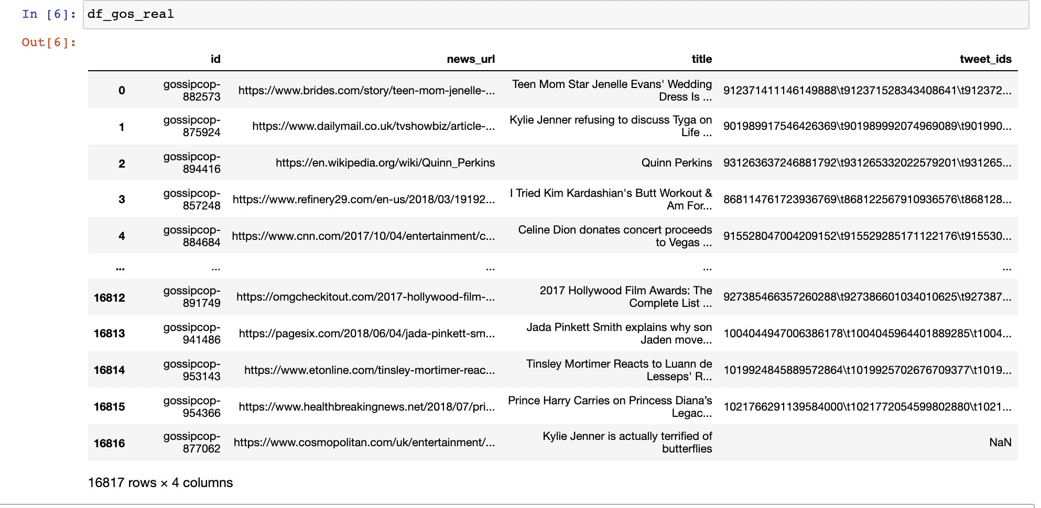
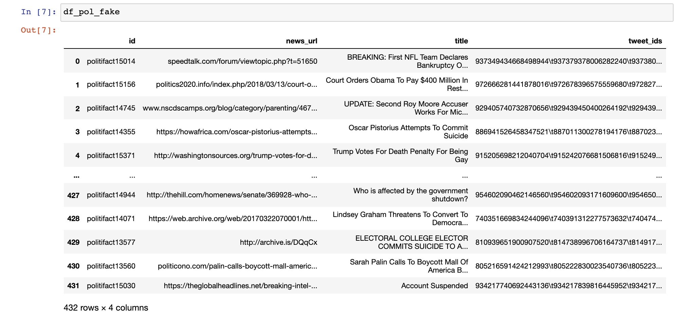
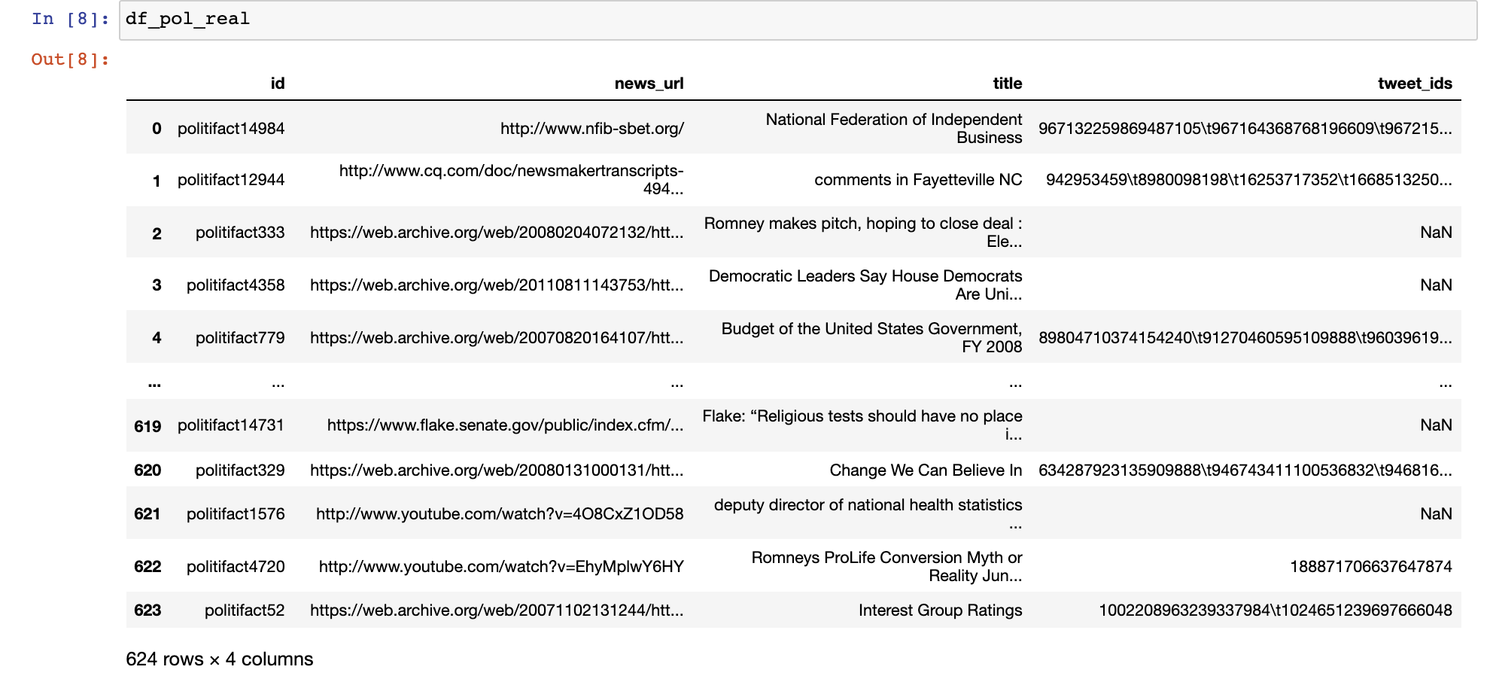

Slide 6
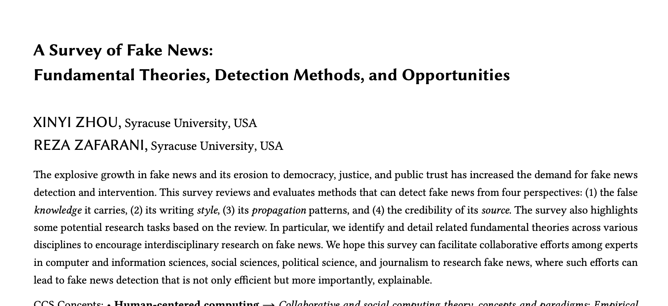
Fundamental theories, detection Methods, and opportunities

Slide 7
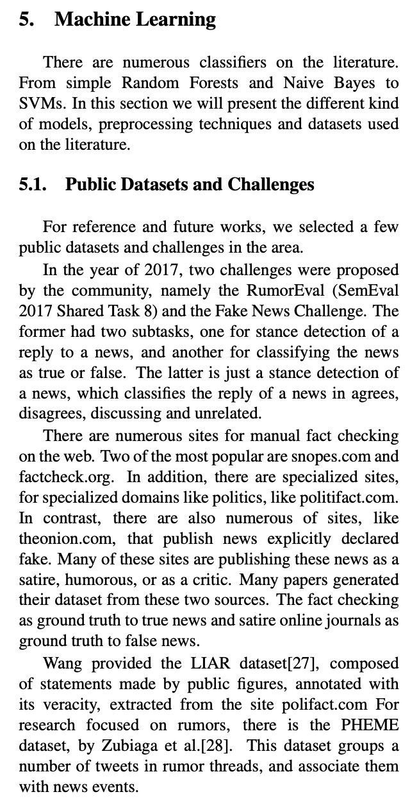
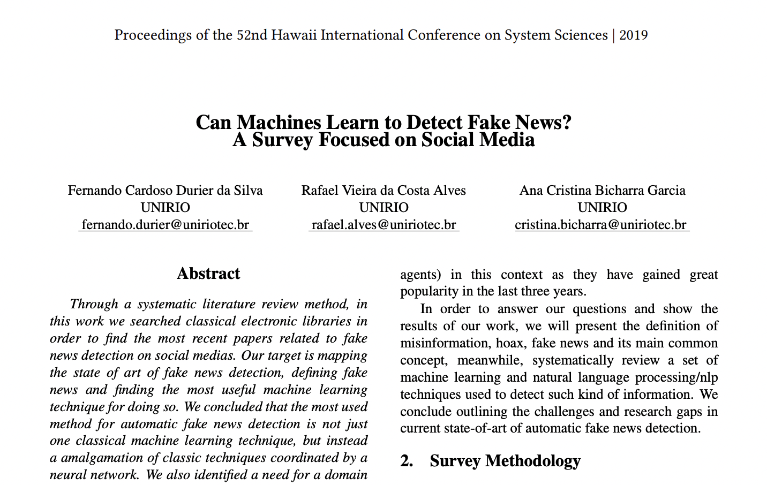
We have gone through some papers and websites and found that In the year of 2017, two challenges were proposed. One had two subtasks, one for stance detection of a reply to a news, and another for classifying the news as true or false.

Slide 8
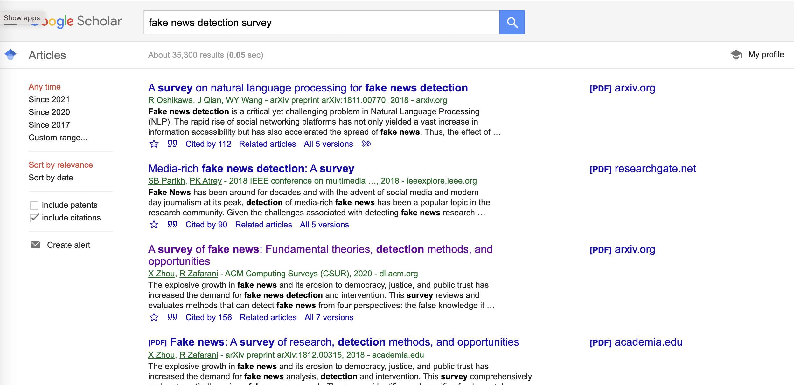
More resource for google scholar and regular google search (fake news detection survey)

Slide 9
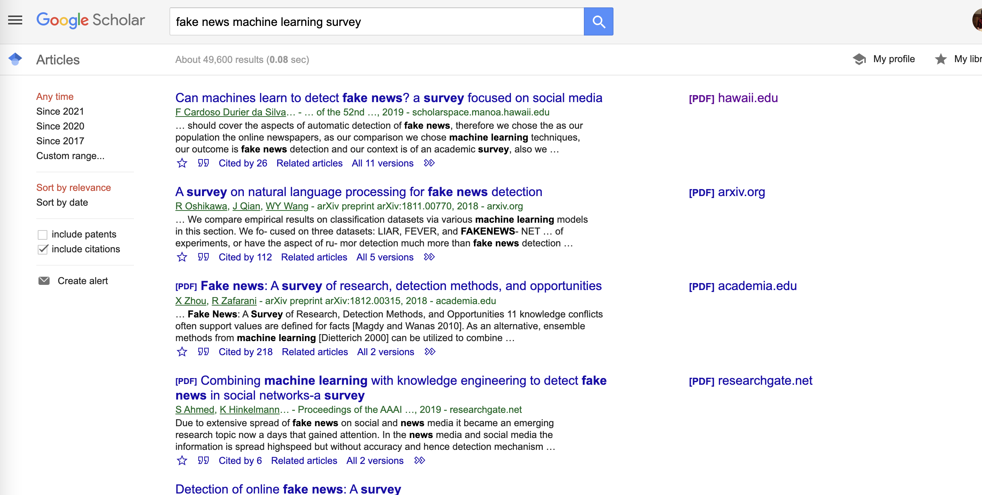
More resource for google scholar and regular google search (fake news machine learning survey)

Slide 10
Summary: How machine learning can be used for fake news detection?

